Slide 1
EMPLOYEE DATA ANALYSIS
NAME – E. GAYATHRI
REG NO – 312214920
DEPARTMENTS - COMMERCE
COLLEGE – ANNAI VEILANKANNIS CALLEGE FOR WOMEN

Slide 2
AGENDA
Fitness statement
Overview end user
Our solution and proposition
Datase5 description
Result and discuss
Conclusion

Slide 3
PROBLEM STATEMENT
Ease of data
Management data
Ease of use versality

Slide 4
WHO ARE THE END USER
Beginners
Enthusiastic
Athletes
Seniors
Rehabilitation

Slide 5
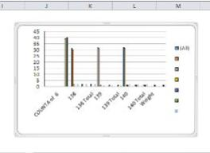
RESULT

Slide 6
CONCLUSION
Achieving optimal fitness is within reach . Bye incorporating physical activity, healthy eating and mindfulness into are daily lives , we can improve are overall well being . Let’s take the first step towards a healthier , happier us – start a fitness journey today .

Slide 7
THANK YOU

